Slide 1
CORE JAVA
NEEHARIKA

Slide 2
Java Annotations
Annotations in Java are utilized to give supplement data about a program.
Java Annotations begin with ‘@’.
Java Annotations don’t change the activity of an ordered program.

Slide 3
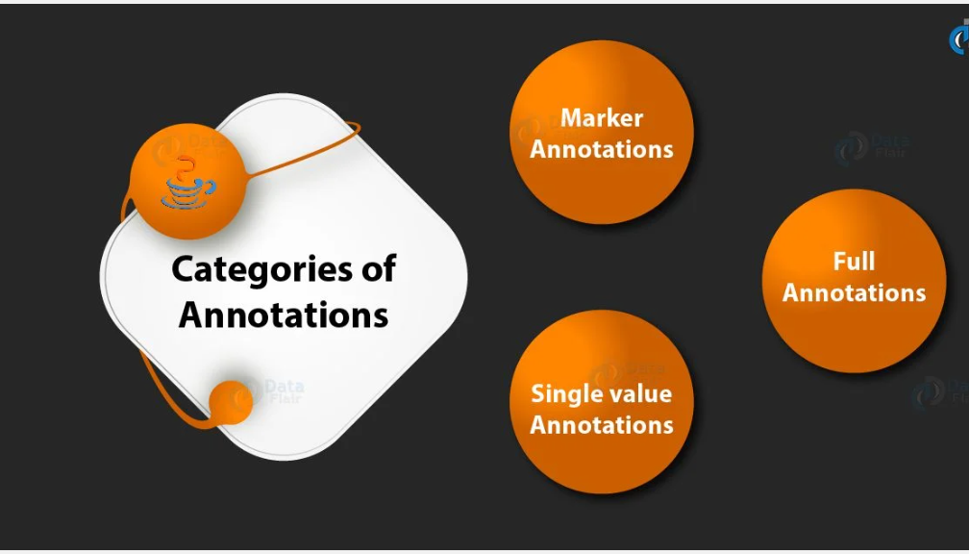

Slide 4
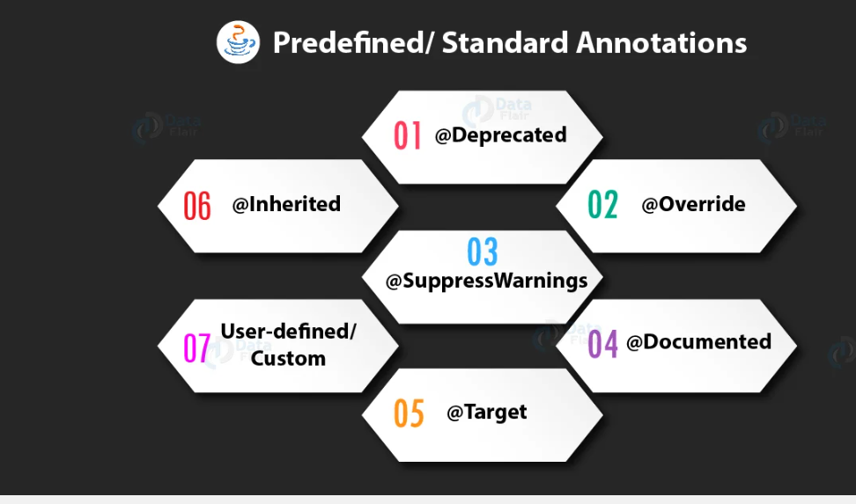

Slide 5
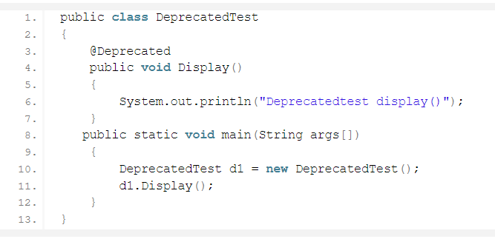

Slide 6

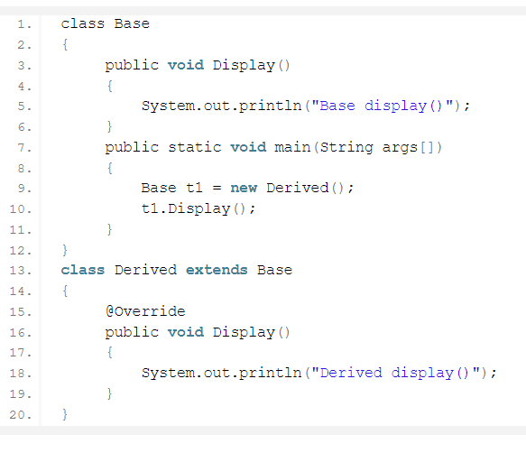

Slide 7

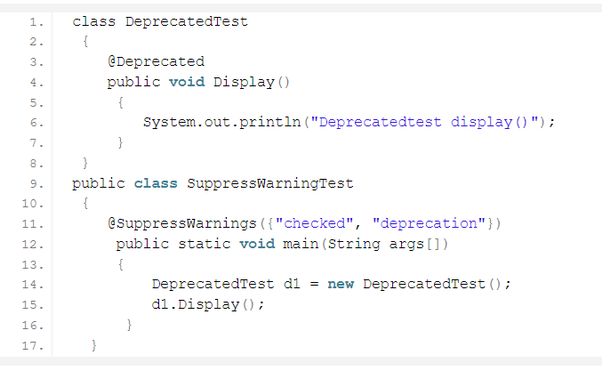

Slide 8
@Documented Annotations @Target Annotations

Slide 9
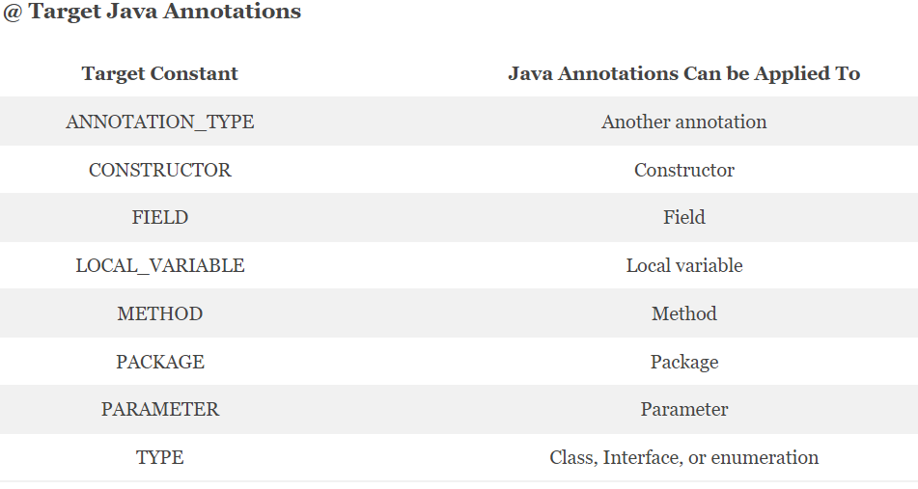

Slide 10
SOURCE: java annotations will hold at the source level and disregarded by the compiler. CLASS: annotations will hold at order time and overlooked by the JVM. RUNTIME: these will hold at runtime.

Slide 11

ENUMS

Slide 12
Java Enums
The Enum in Java is a data type which contains a fixed set of constants.

Slide 13
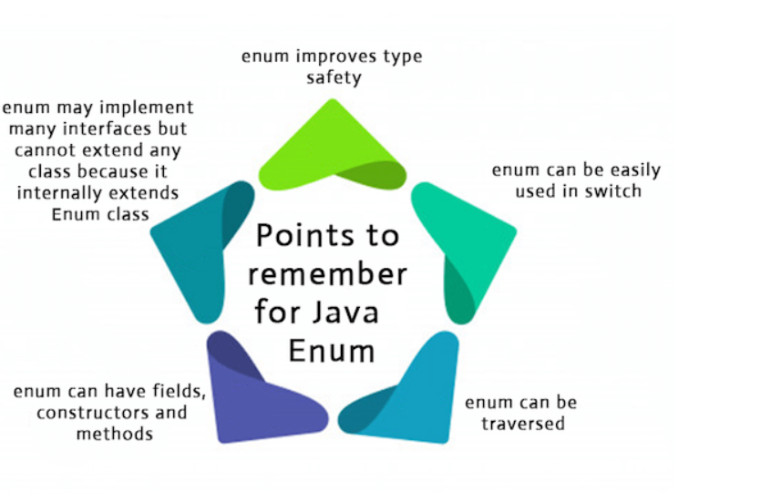

Slide 14
Defining Enum
The enum can be defined within or outside the class because it is similar to a class. The semicolon (;) at the end of the enum constants are optional

Slide 15
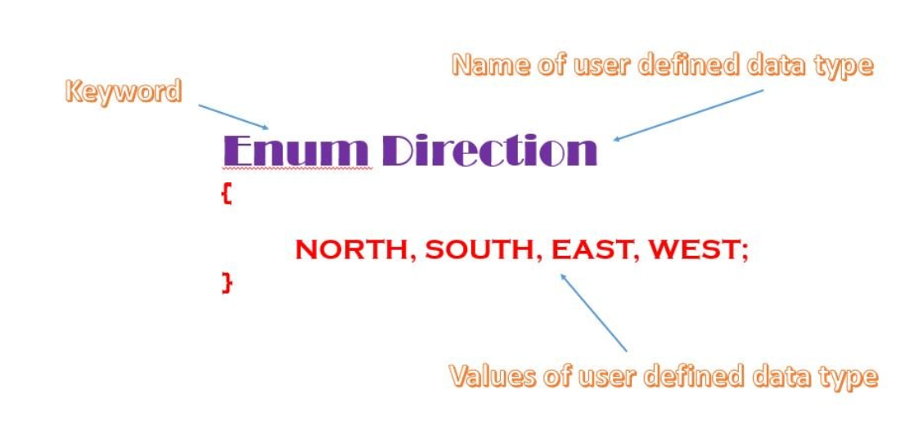
Syntax of declaring enum

Slide 16
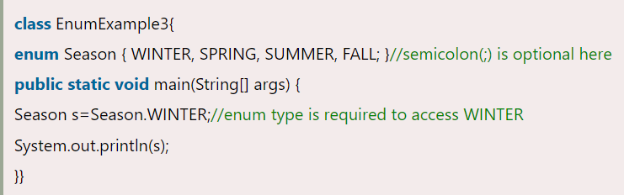
Enum Example: Defined inside class

Slide 17
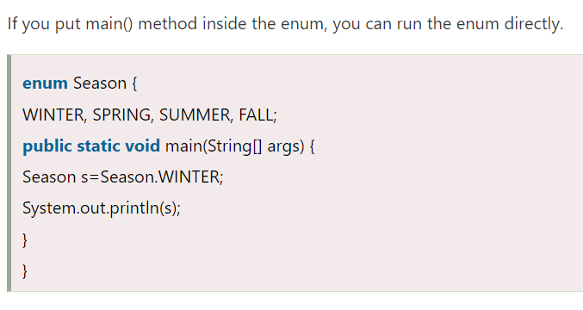
Java Enum Example: main method inside Enum

Slide 18
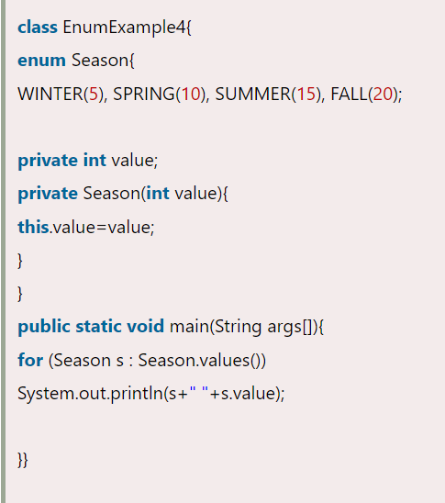
Initializing specific values to the enum constants

Slide 19
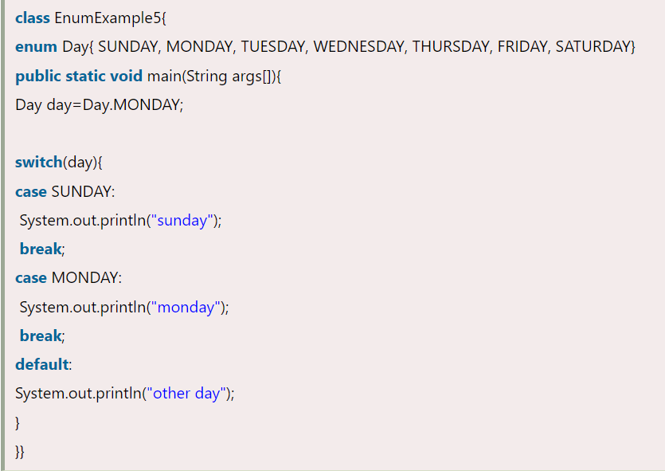
Java Enum in a switch statement

Slide 20
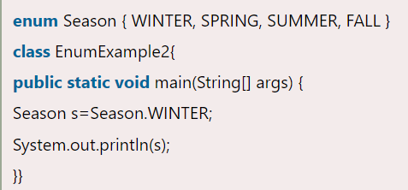
Java Enum Example: Defined outside class

Slide 21
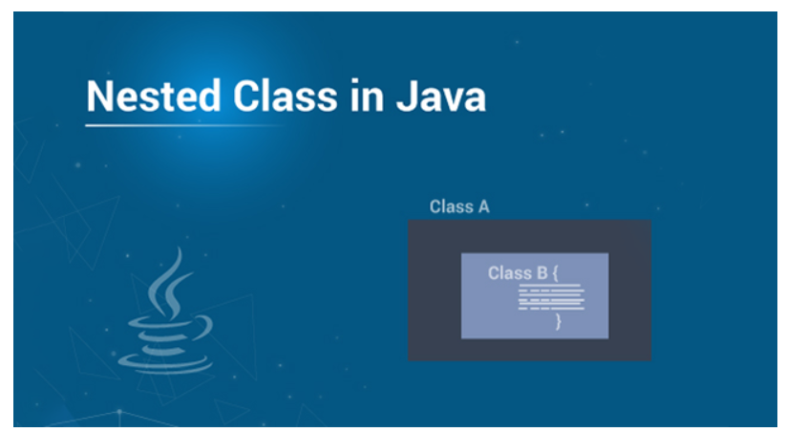

Slide 22
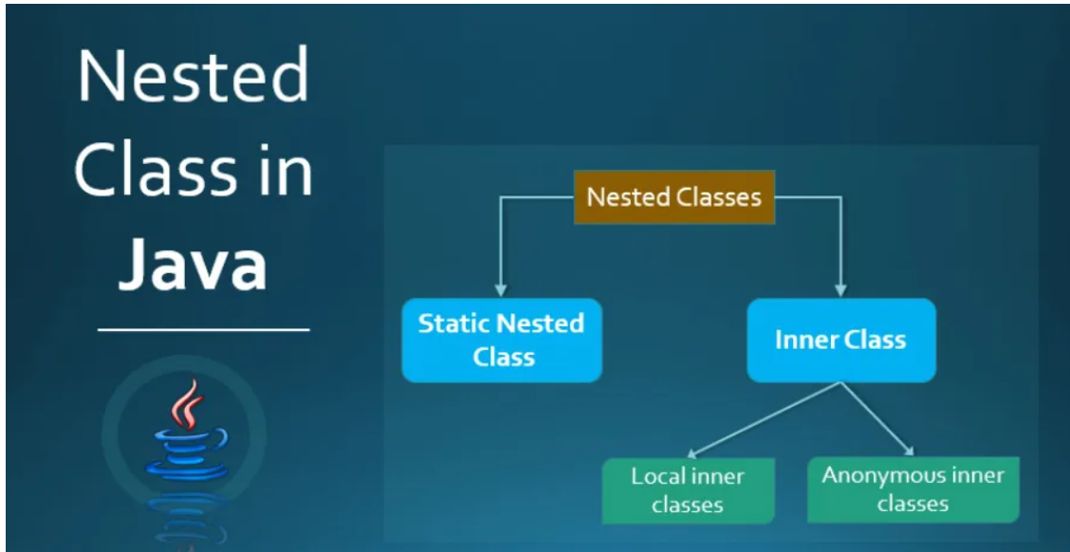

Slide 23
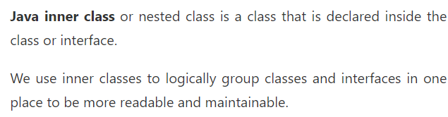
Java Inner Classes (Nested Classes)

Slide 24
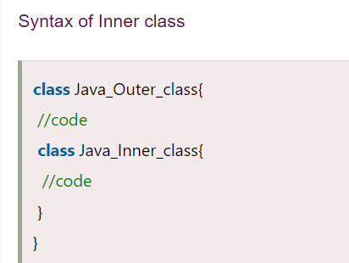

Slide 25
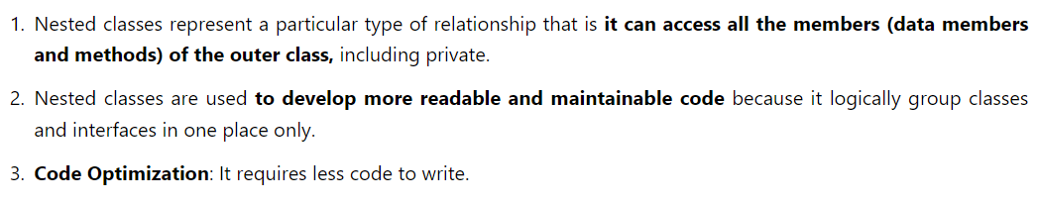
Advantage of inner classes

Slide 26
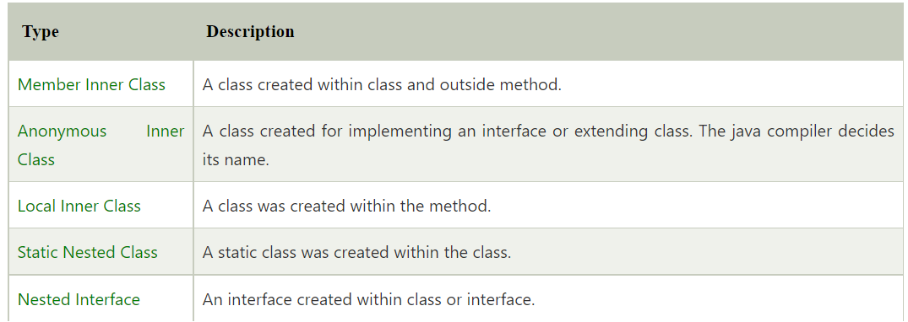
Types of Nested classes

Slide 27
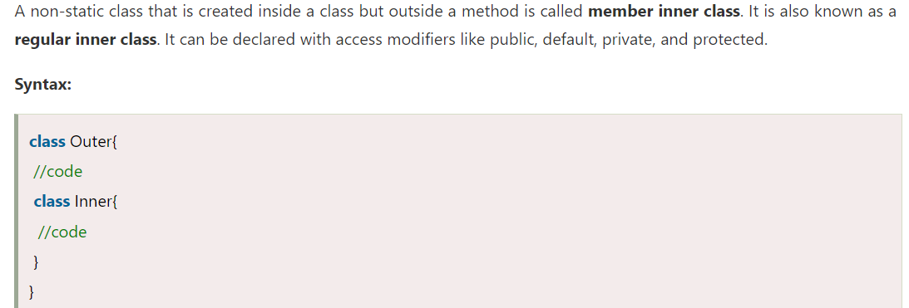
Java Member Inner class

Slide 28
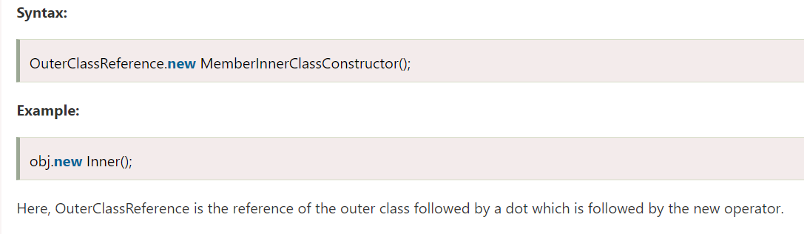
How to instantiate Member Inner class in Java?

Slide 29
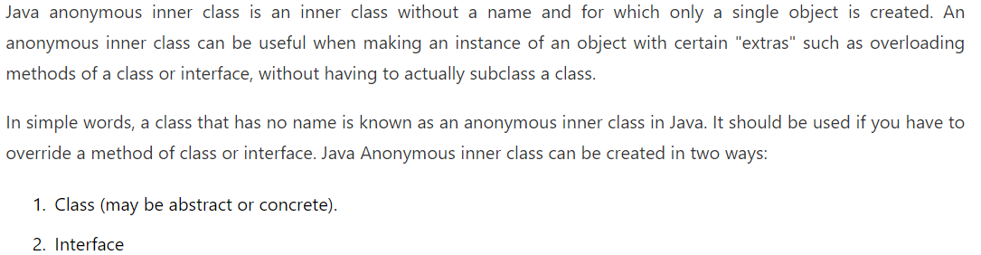
Java Anonymous inner class

Slide 30
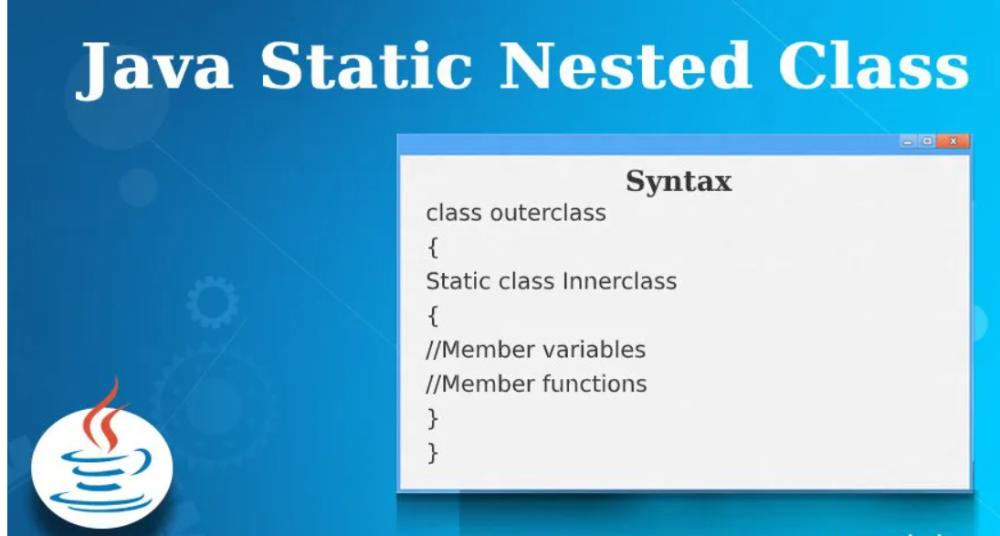

Slide 31
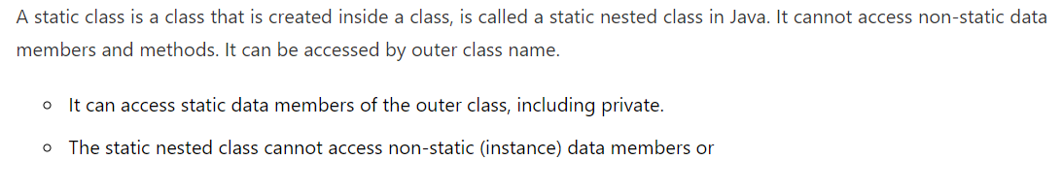
Java static nested class

Slide 32
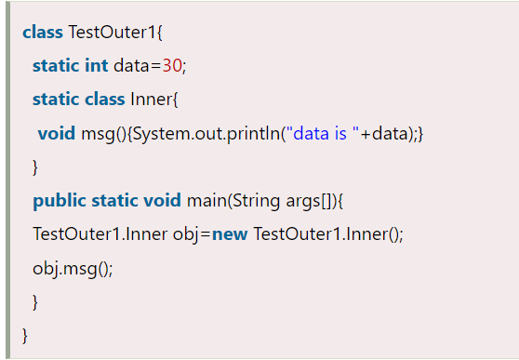
Java static nested class example with instance method

Slide 33
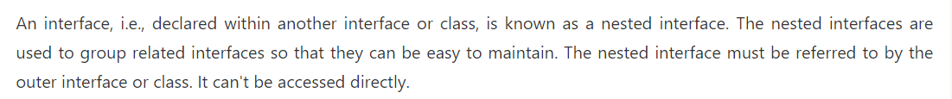
Java Nested Interface

Slide 34
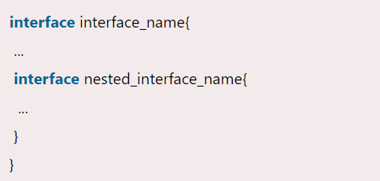
Syntax of nested interface which is declared within the interface

Slide 35
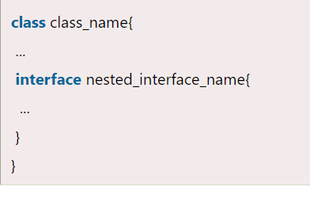
Syntax of nested interface which is declared within the class

Slide 36
Thank you

